Slide 1
Biotech Medical Technologies: Revolutionizing Healthcare
Exploring the Impact of Technology in Medicine
By: Ahiave Kekeli Oluwatomisin 05/04/2023

Slide 2
Introduction to Biotech Medical Technologies
Biotech Medical Technologies
Biotech Medical Technologies revolutionize healthcare by integrating technology to enhance services and improve patient outcomes. These innovations leverage advancements in biology, genetics, data analytics, and artificial intelligence to enable accessible, efficient, and personalized healthcare delivery. By facilitating remote consultations, telemedicine, digital health records, and predictive analytics, Biotech Medical Technologies transform traditional medical practices and promote patient-centric care. Better patient-centric outcomes.
In summary, the presentation offers a detailed exploration of Biotech Medical Technologies, emphasizing its transformative impact on healthcare accessibility and patient empowerment through technology.
Importance in making healthcare accessible through technology
Access to healthcare services remotely, overcoming barriers such as geographical distance and physical mobility limitations. Patients can consult healthcare professionals through telemedicine platforms, reducing the need for in-person visits and providing timely medical assistance, especially in underserved areas.
Digital Health Records: By digitizing health records and making them accessible online, Biotech Medical Technologies streamline the healthcare process. Patients can easily retrieve their medical history, track their health metrics, and share information with healthcare providers, leading to more informed decision-making, better continuity of care, and improved health outcomes.

Slide 3
Applications of Biotech Medical Technologies
Online Registration and Appointment System
Biotech Medical Technologies offers an Online Registration and Appointment System, facilitating easy access to healthcare services. Patients can conveniently schedule appointments online, improving efficiency and accessibility. This digital platform empowers patients to manage their healthcare needs conveniently, enhancing the overall healthcare experience.
Biotech Medical Technologies prioritizes comfort. hassle-free patient orientation, providing comprehensive online guides and downloadable patient forms. By offering these resources, patients can familiarize themselves with procedures and requirements before their visit, reducing stress and enhancing preparedness. This approach fosters a patient-centric environment focused on convenience and comfort.
Online Guides, Downloadable Patient Forms, and Health Magazines
Biotech Medical Technologies enhances patient experience through online resources, including guides, downloadable forms, and health magazines. These tools empower patients to navigate procedures, access necessary forms, and stay informed about healthcare topics. Ultimately, Biotech aims to streamline processes and empower patients to actively participate in their health journey.

Slide 4
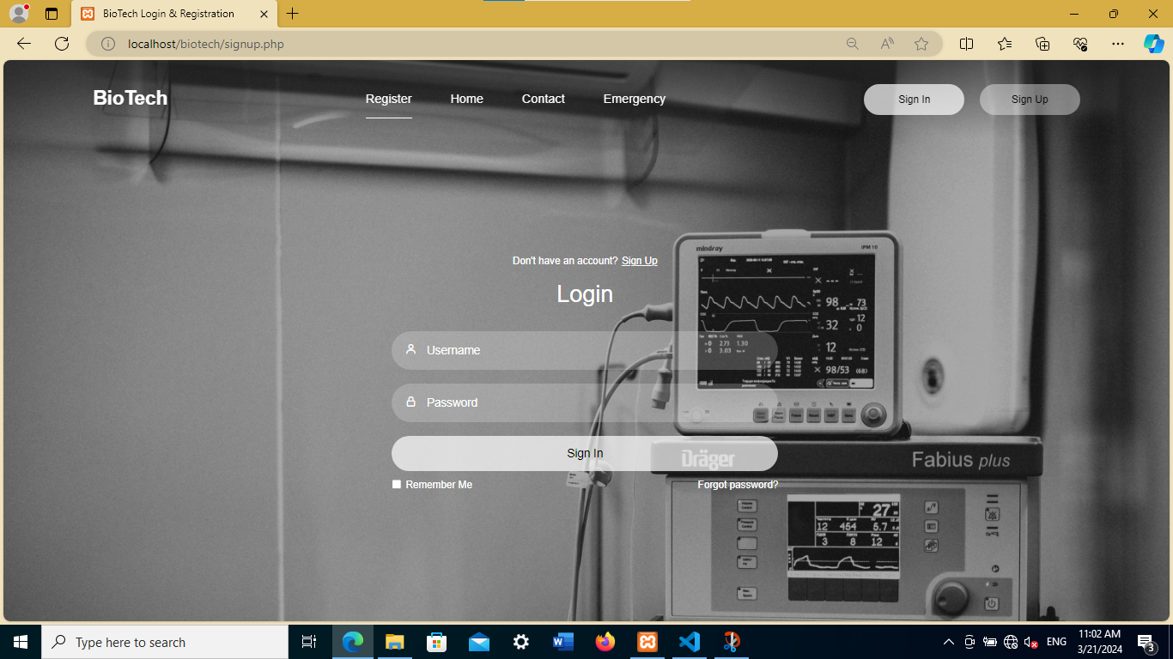
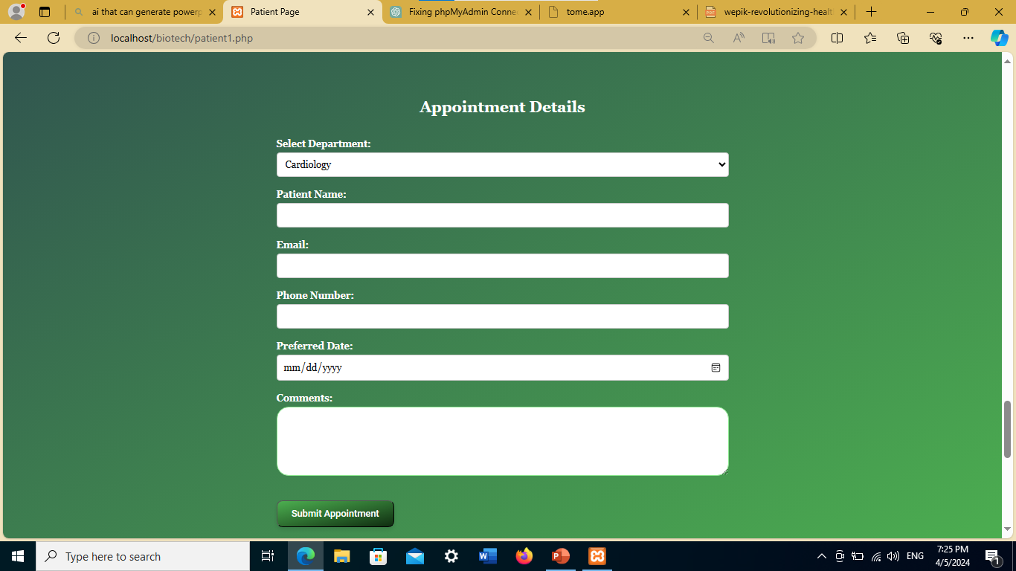
Online Registration and Appointment System
Biotech Medical Technologies leverages smartphone technology to provide easy access to healthcare services. By utilizing smartphones, patients can conveniently access the platform from anywhere, enabling seamless interaction with medical services.
Biotech Medical Technologies offers a convenient appointment scheduling system, allowing patients to book appointments with healthcare providers easily. Through the platform, patients can schedule appointments at their preferred date and time, eliminating the need for lengthy phone calls or in-person visits.

Slide 5
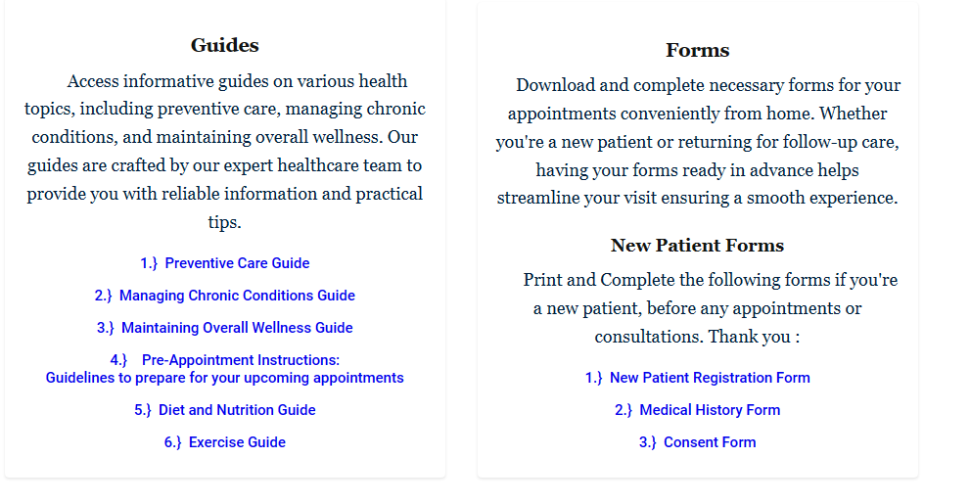
Hassle-Free Patient Orientation
Biotech Medical Technologies enhances patient experience through comprehensive online guides, offering valuable insights into hospital facilities, services, and departmental information. This proactive approach empowers patients to navigate the hospital system confidently, reducing stress and confusion during their visits. By providing easy access to essential information online, Biotech ensures a seamless and efficient experience for patients, contributing to overall satisfaction and well-being.
Biotech Medical Technologies facilitates patient convenience by offering downloadable forms, enabling individuals to complete necessary paperwork in advance of their appointments. This proactive measure streamlines administrative processes, reducing wait times and enhancing overall efficiency within the healthcare system. By empowering patients to prepare documentation beforehand, Biotech ensures smoother interactions during their visits, optimizing both patient and staff experience.

Slide 6
Future Trends and Innovations
Biotech Medical Technologies will integrate telemedicine solutions to provide remote consultations, offering patients access to healthcare professionals from the comfort of their homes in the near future. This innovative approach expands healthcare accessibility, particularly for individuals in remote or underserved areas, or those with limited mobility. Through telemedicine, patients can receive timely medical advice, diagnosis, and treatment recommendations without the need for physical appointments. This not only enhances patient convenience but also reduces healthcare costs associated with travel and wait times. Moreover, it fosters a more patient-centered approach to healthcare delivery, ensuring individuals receive timely and personalized care regardless of their location.
Another of our advances for the future will be wearable health monitoring devices to provide real-time tracking of vital signs and health metrics. This proactive approach enables remote patient monitoring and promotes early detection of health issues. By integrating wearable technology, Biotech empowers individuals to take control of their health and facilitates personalized healthcare delivery.
Biotech Medical Technologies will leverage more in the advancements in artificial intelligence (AI) to offer personalized treatment recommendations to patients. Through sophisticated algorithms and data analysis, AI enables the identification of individual health patterns and preferences. This tailored approach enhances patient outcomes by providing targeted interventions and optimizing treatment plans. By harnessing the power of AI, Biotech ensures that each patient receives personalized care that aligns with their unique needs and circumstances.

Slide 7
Recap of the impact of Biotech Medical Technologies on healthcare accessibility
Biotech Medical Technologies has revolutionized healthcare accessibility through innovative solutions such as online appointment scheduling, hassle-free patient orientation, telemedicine integration, wearable health monitoring, and AI-driven personalized treatment recommendations. These advancements have significantly improved access to healthcare services, streamlined patient experiences, extended medical expertise remotely, enabled continuous health monitoring, and tailored treatment plans to individual needs, ultimately enhancing overall healthcare outcomes and making quality healthcare more accessible to all.
In summary, Biotech Medical Technologies harnesses the power of technology to enhance patient experiences and improve healthcare accessibility..
Through online platforms, telemedicine integration, wearable devices, and AI-driven solutions, patients benefit from convenient access to care, personalized treatment recommendations, and proactive health monitoring These advancements not only streamline administrative processes but also empower patients with valuable information and resources, ultimately leading to better healthcare outcomes and increased patient satisfaction.
Let's continue to push the boundaries of innovation and advancement through Biotech Medical Technologies, ensuring that healthcare remains accessible to all individuals. By investing in research, development, and implementation of cutting-edge technologies, we can further revolutionize the way healthcare is delivered and experienced. Together, let's strive to create a future where everyone has equal access to high-quality care and where technology serves as a catalyst for positive change in the medical field.

